Slide 1

COMP1631 Advanced Spreadsheets – Winter 2024 – Section 06

Slide 2
COMP1631 Advanced Spreadsheets – Winter 2024 – Section 06
Lecture 4 Tuesday, January 30, 2024
Today:
Module 6 objectives
Module 6 Case Problem 1 (demo)
Module 6 Notes
Excel Module 6 SAM Textbook Project

Slide 3
COMP1631 Advanced Spreadsheets – Winter 2024 – Section 06
Module 6: Managing Data with Data Tools
Objectives
Split a workbook window into panes
Highlight and remove duplicate values in a data range
Sort a data range by one or more fields
Add subtotals to a data range
Find and select workbook cells
Filter data based on one or more fields
Create an advanced filter
Convert a data range to an Excel table
Work with table styles and table elements
Create and apply a slicer
Calculate summary statistics with the SUBTOTAL function
Design and create an interactive dashboard

Slide 4
COMP1631 Advanced Spreadsheets – Winter 2024 – Section 06
Module 6: Managing Data with Data Tools
Objectives
Split a workbook window into panes
Highlight and remove duplicate values in a data range
Sort a data range by one or more fields
Add subtotals to a data range
Find and select workbook cells
Filter data based on one or more fields
Create an advanced filter
Convert a data range to an Excel table
Work with table styles and table elements
Create and apply a slicer
Calculate summary statistics with the SUBTOTAL function
Design and create an interactive dashboard

Slide 5
COMP1631 Advanced Spreadsheets – Winter 2024 – Section 06
Module 6: Managing Data with Data Tools
Objectives
Split a workbook window into panes
Highlight and remove duplicate values in a data range
Sort a data range by one or more fields
Add subtotals to a data range
Find and select workbook cells
Filter data based on one or more fields
Create an advanced filter
Convert a data range to an Excel table
Work with table styles and table elements
Create and apply a slicer
Calculate summary statistics with the SUBTOTAL function
Design and create an interactive dashboard

Slide 6
COMP1631 Advanced Spreadsheets – Winter 2024 – Section 06
Module 6: Managing Data with Data Tools
Objectives
Split a workbook window into panes
Highlight and remove duplicate values in a data range
Sort a data range by one or more fields
Add subtotals to a data range
Find and select workbook cells
Filter data based on one or more fields
Create an advanced filter
Convert a data range to an Excel table
Work with table styles and table elements
Create and apply a slicer
Calculate summary statistics with the SUBTOTAL function
Design and create an interactive dashboard

Slide 7
COMP1631 Advanced Spreadsheets – Winter 2024 – Section 06
6.1 Data Ranges, Workbook Panes, and Subtotals
Handling Data in Excel
Excel is a popular application for storing data and includes tools for managing and exploring that data.
In a data range, each column stores information known as a field describing a characteristic of a person, place, or thing and each row stores a record containing a group of related field values.
The first row of a data range, known as the header row , typically contains the field names.

Slide 8
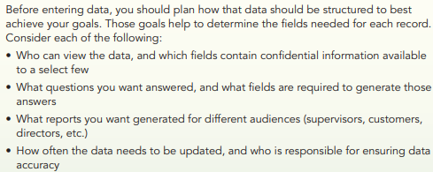
COMP1631 Advanced Spreadsheets – Winter 2024 – Section 06

Slide 9
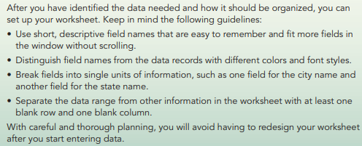
COMP1631 Advanced Spreadsheets – Winter 2024 – Section 06

Slide 10
COMP1631 Advanced Spreadsheets – Winter 2024 – Section 06
With any data range, it’s excellent practice to provide a data definition table, which lists
the fields included with each record,
the type of data stored in each field (such as numbers, text, or dates),
a short description of each field.

Slide 11
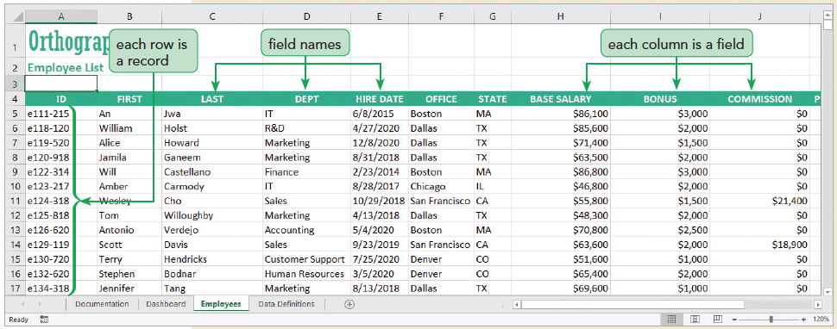
COMP1631 Advanced Spreadsheets – Winter 2024 – Section 06

Slide 12
COMP1631 Advanced Spreadsheets – Winter 2024 – Section 06
Quick Quiz 1
Group Response:
The first row of a data range is known as the ___________ row.
What is a data definition table?
Class Discussion:
What are the guidelines discussed in this module to keep in mind when you set up your worksheet?

Slide 13
COMP1631 Advanced Spreadsheets – Winter 2024 – Section 06
Group Response:
The first row of a data range is known as the ___________ row. (Answer: header)
What is a data definition table? (Answer: A data definition table lists the fields included with each record, the type of data stored in each field, and a short description of each field.)
Class Discussion: What are the guidelines discussed in this module to keep in mind when you set up your worksheet?
(Answer: Use short, descriptive field names that are easy to remember and fit more fields in the window without scrolling. Distinguish field names from the data records with different colors and font styles. Break fields into single units of information, such as one field for the city name and another field for the state name. Separate the data range from other information in the worksheet with at least one blank row and one blank column.)

Slide 14
COMP1631 Advanced Spreadsheets – Winter 2024 – Section 06
Using Panes to View Data
Dividing the Workbook Window into Panes
Excel can split the workbook window in up to four sections called panes with each pane offering a separate view into the worksheet
Freezing Panes
When you freeze a pane, its contents are always visible though you cannot scroll within it. You can freeze the panes located to the top and left of a selected cell, allowing scrolling within the lower-right pane

Slide 15
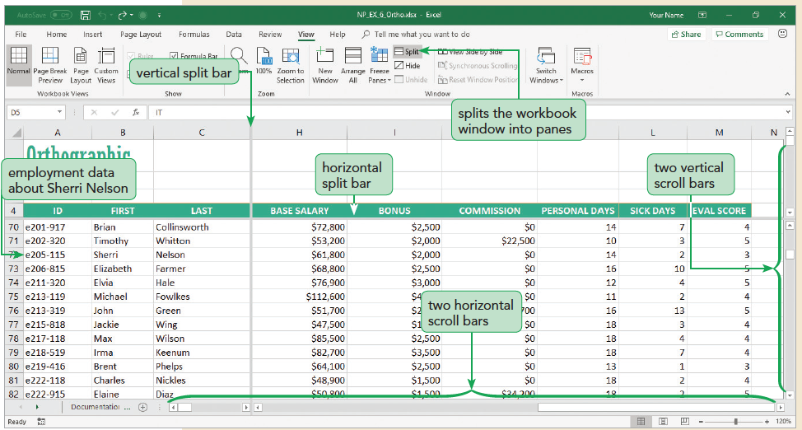
COMP1631 Advanced Spreadsheets – Winter 2024 – Section 06

Slide 16
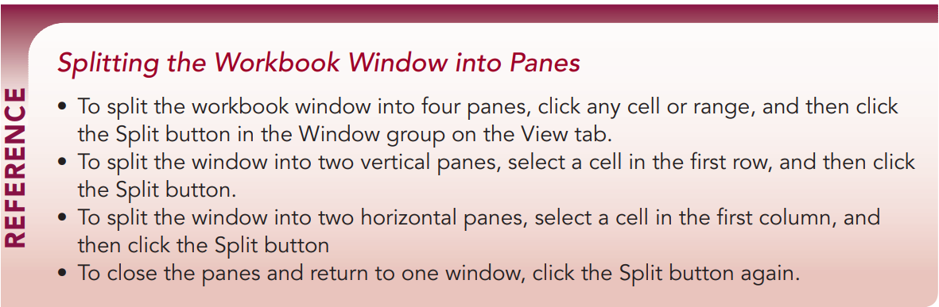
COMP1631 Advanced Spreadsheets – Winter 2024 – Section 06

Slide 17
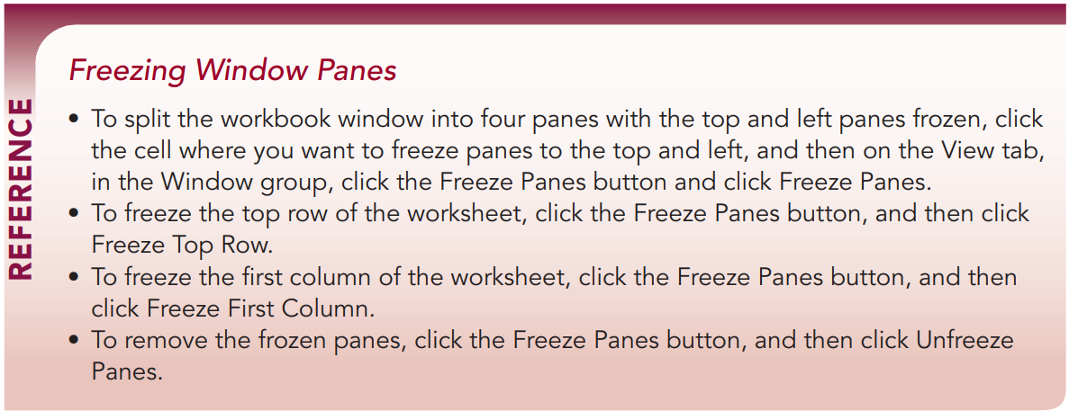
COMP1631 Advanced Spreadsheets – Winter 2024 – Section 06

Slide 18
COMP1631 Advanced Spreadsheets – Winter 2024 – Section 06
Quick Quiz 2
True/False: Excel can split the workbook window into three sections, called panes
To split the workbook window, click any cell or range in the worksheet and then on the _____ tab, click the Split button.
True/False: You can split the window into vertical panes.
When you ______ a pane, its contents are always visible though you cannot scroll within it.

Slide 19
COMP1631 Advanced Spreadsheets – Winter 2024 – Section 06
True/False: Excel can split the workbook window into three sections, called panes. (Answer: False, four sections)
To split the workbook window, click any cell or range in the worksheet and then on the _____ tab, click the Split button. (Answer: View)
True/False: You can split the window into vertical panes. (Answer: True)
When you ______ a pane, its contents are always visible though you cannot scroll within it. (Answer: freeze)

Slide 20
COMP1631 Advanced Spreadsheets – Winter 2024 – Section 06
Locating Duplicate Records
When a worksheet has a lot of data, data entry errors are almost sure to occur.
One common error is creating a duplicate record in which the same record appears multiple times in the worksheet.

Slide 21
COMP1631 Advanced Spreadsheets – Winter 2024 – Section 06
Highlighting Duplicate Values
You can use conditional formatting to locate a duplicate record by highlighting duplicate values within a selected range
Removing Duplicate Records
Click any cell in the data range.
On the Data tab, in the Data Tools group, click the Remove Duplicates button.
Select the check boxes for the fields that you want to check for duplicates.
Click OK to remove records containing duplicates of all of the selected fields.

Slide 22
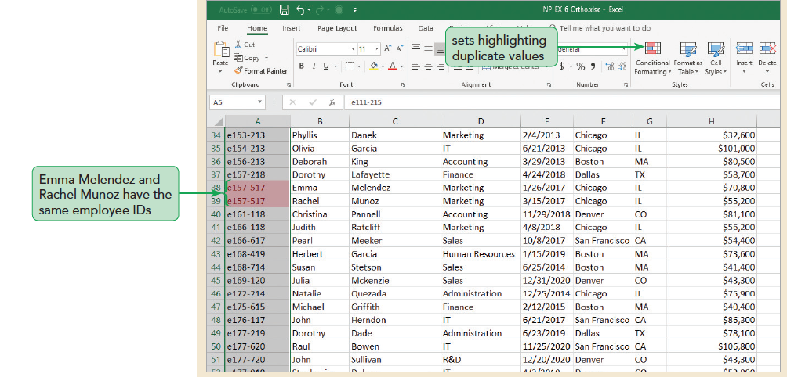
COMP1631 Advanced Spreadsheets – Winter 2024 – Section 06

Slide 23
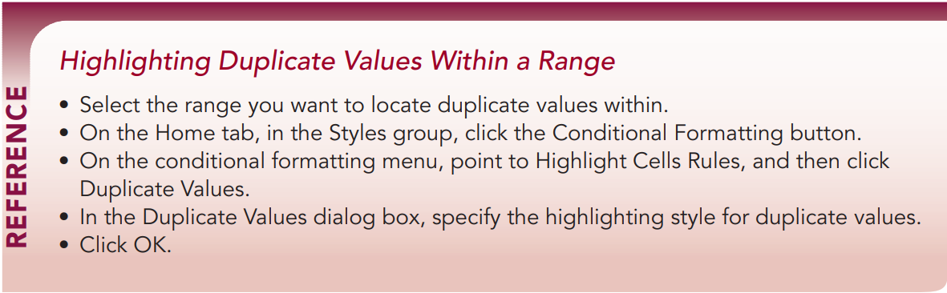
COMP1631 Advanced Spreadsheets – Winter 2024 – Section 06

Slide 24
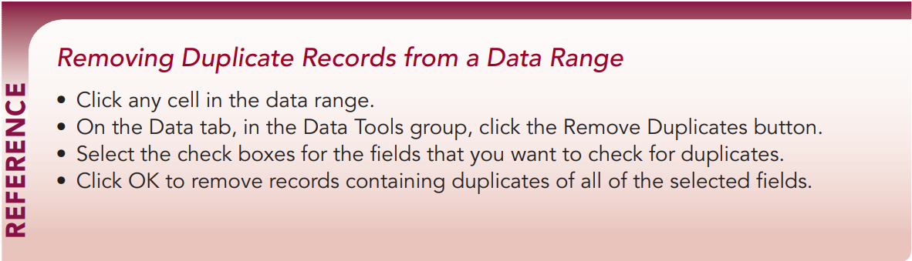
COMP1631 Advanced Spreadsheets – Winter 2024 – Section 06

Slide 25
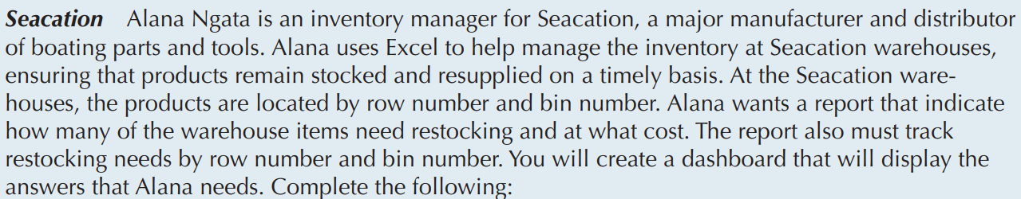
COMP1631 Advanced Spreadsheets – Winter 2024 – Section 06
In class Demo:

Slide 26
COMP1631 Advanced Spreadsheets – Winter 2024 – Section 06
In class Demo:

Slide 27
COMP1631 Advanced Spreadsheets – Winter 2024 – Section 06
Quick Quiz 3
You can use ___________ formatting to locate a duplicate record by highlighting duplicate values with a selected range.
Which tool would you use to locate and delete records that are duplicated across multiple fields?

Slide 28
COMP1631 Advanced Spreadsheets – Winter 2024 – Section 06
You can use ___________ formatting to locate a duplicate record by highlighting duplicate values with a selected range. (Answer: conditional)
Which tool would you use to locate and delete records that are duplicated across multiple fields? (Answer: Remove Duplicates)

Slide 29
COMP1631 Advanced Spreadsheets – Winter 2024 – Section 06
Sorting Records in a Data Range
Sorting by a Single Field
The records in an Excel table initially appear in the order they were entered; you can view the same records in a different order
Ascending order arranges text alphabetically from A to Z, numbers from smallest to largest, and dates from oldest to newest
Descending order arranges text in reverse alphabetical order from Z to A, numbers from largest to smallest, and dates from newest to oldest
Use the Sort A to Z button or the Sort Z to A button to sort data quickly with one sort field

Slide 30
COMP1631 Advanced Spreadsheets – Winter 2024 – Section 06
Sorting by Multiple Fields
The first sort field is called the primary sort field
The second sort is called the secondary sort field
Up to 64 sort fields possible
Sorting with a Custom List
A custom list indicates sequence to order data
Two predefined custom sort lists
Day-of-the-week custom list
Month-of-the-year custom lists
Can create a custom list to sort records in a sequence you define

Slide 31
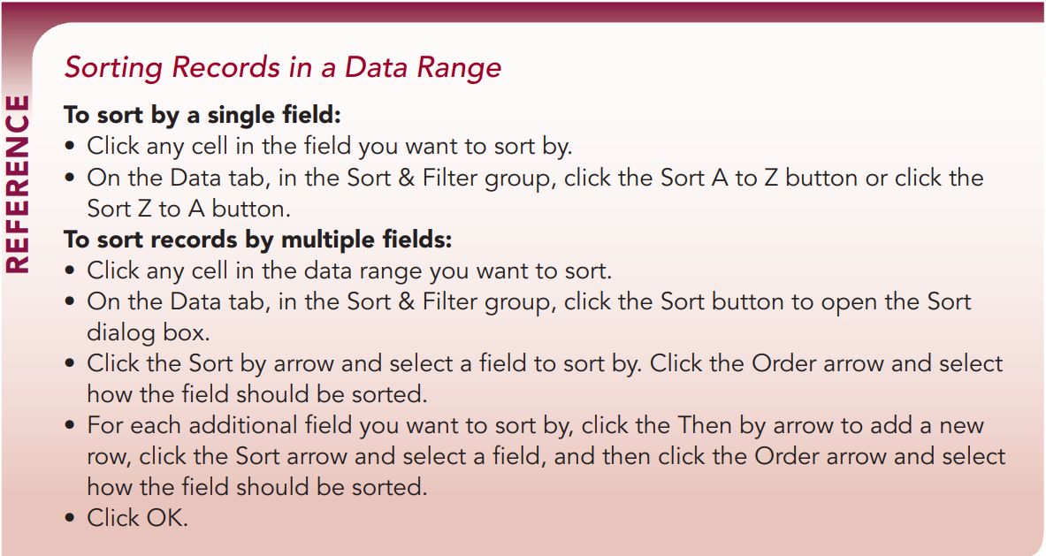
COMP1631 Advanced Spreadsheets – Winter 2024 – Section 06

Slide 32
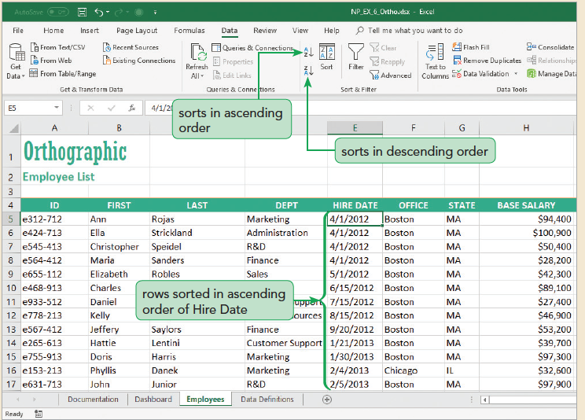
COMP1631 Advanced Spreadsheets – Winter 2024 – Section 06

Slide 33
COMP1631 Advanced Spreadsheets – Winter 2024 – Section 06
Demo NP_EX_6_Seacation:

Slide 34
COMP1631 Advanced Spreadsheets – Winter 2024 – Section 06
Quick Quiz 4
Group Work
True/False: By default, records appear in ascending order.
Sorting records from Z to A is _____________ order.
A _______________ arranges field values in the order you specify.
Class Discussion: What is the difference between primary sort field and secondary sort field?

Slide 35
COMP1631 Advanced Spreadsheets – Winter 2024 – Section 06
True/False: By default, records appear in ascending order. (Answer: False)
Sorting records from Z to A is _____________ order. (Answer: descending)
A _______________ arranges field values in the order you specify. (Answer: custom list)
Class Discussion: What is the difference between primary sort field and secondary sort field?
(Answer: A primary sort field initially sorts the data and the secondary sort field sorts data within the primary sort field.)

Slide 36
COMP1631 Advanced Spreadsheets – Winter 2024 – Section 06
Calculating Subtotals
Creating a Subtotal Row
Some analysis requires calculations on sections of a data range. To do this, you can add subtotals , which are summary functions that are applied to a part of a data range
Using the Subtotal Outline View
The outline tool lets you control the level of detail displayed in the worksheet.

Slide 37
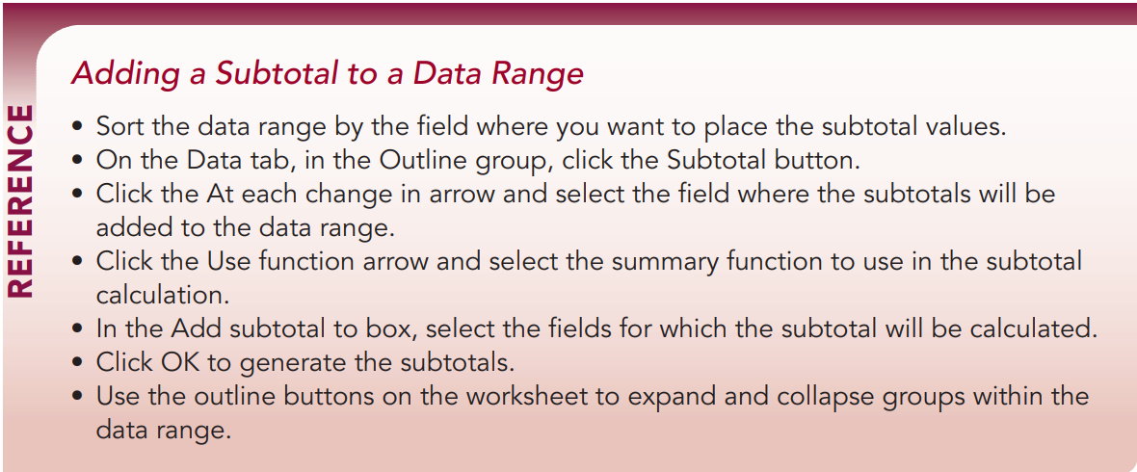
COMP1631 Advanced Spreadsheets – Winter 2024 – Section 06

Slide 38
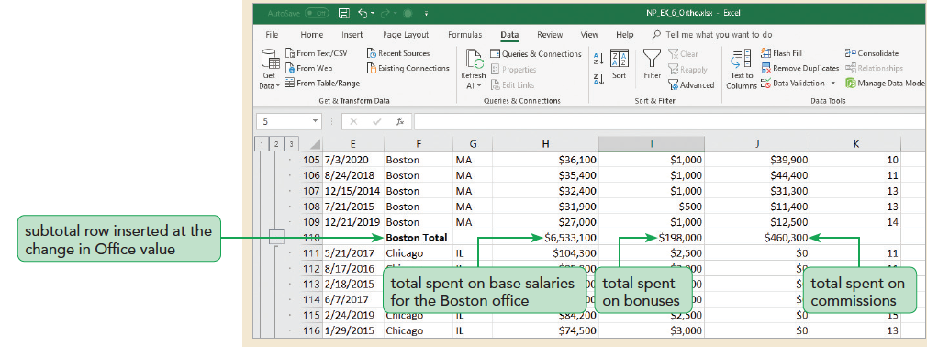
COMP1631 Advanced Spreadsheets – Winter 2024 – Section 06

Slide 39
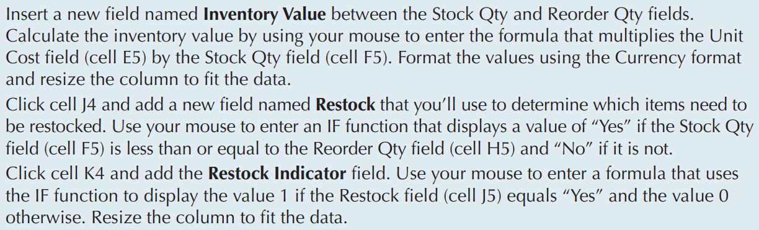
COMP1631 Advanced Spreadsheets – Winter 2024 – Section 06
Demo NP_EX_6_Seacation:

Slide 40
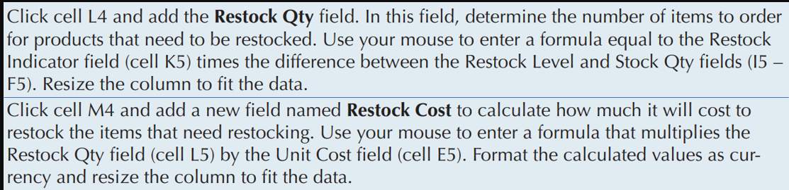
COMP1631 Advanced Spreadsheets – Winter 2024 – Section 06
Demo NP_EX_6_Seacation:

Slide 41
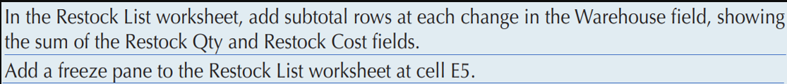
COMP1631 Advanced Spreadsheets – Winter 2024 – Section 06
Demo NP_EX_6_Seacation:

Slide 42
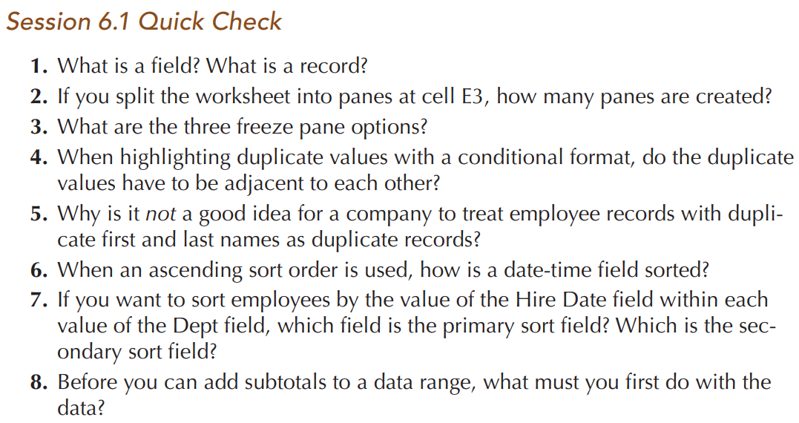
COMP1631 Advanced Spreadsheets – Winter 2024 – Section 06
Individual Work: https://forms.office.com/r/2W4TCcqKda

Slide 43
COMP1631 Advanced Spreadsheets – Winter 2024 – Section 06
Let’s go for a break ~ 10 minutes!
Return in 15 minutes (or at time specified by your instructor).

Slide 44
COMP1631 Advanced Spreadsheets – Winter 2024 – Section 06
6.2 Filters and Excel Tables
Locating Cells Within a Worksheet
Finding and Selecting Multiple Cells
Find & Select can locate cells that match a specified criterion. For example, you can use Find & Select to locate employees by their last name, base salary, or date of hire.
Finding Cells by Type
Find & Select can also locate cells based on criteria other than cell value, such as whether the cell contains a formula, constant, blank, or conditional formatting rule.

Slide 45

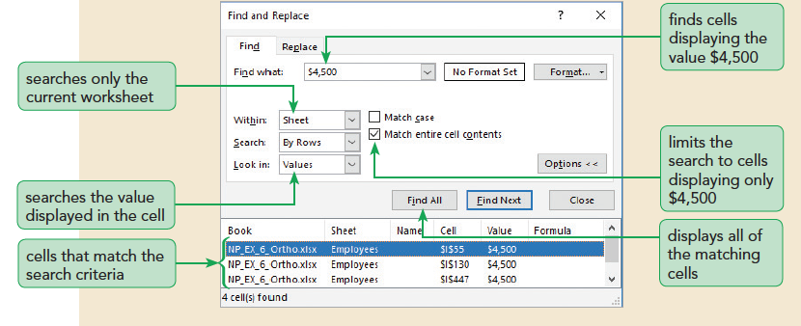
COMP1631 Advanced Spreadsheets – Winter 2024 – Section 06

Slide 46
COMP1631 Advanced Spreadsheets – Winter 2024 – Section 06
Filtering Data
Filtering Based on One Field
Filtering data hides the rows whose values do not match the search criteria. Those rows are not removed from the worksheet. They can be redisplayed by removing the filter or applying a new filter
Filtering Based on Multiple Columns
You can filter a data range based on criteria from multiple fields. Each additional filter reduces the number of records displayed since a record has to fulfill all filter criteria to be selected.
To use filters from multiple fields, select the filter button from other column headers in the data range.

Slide 47
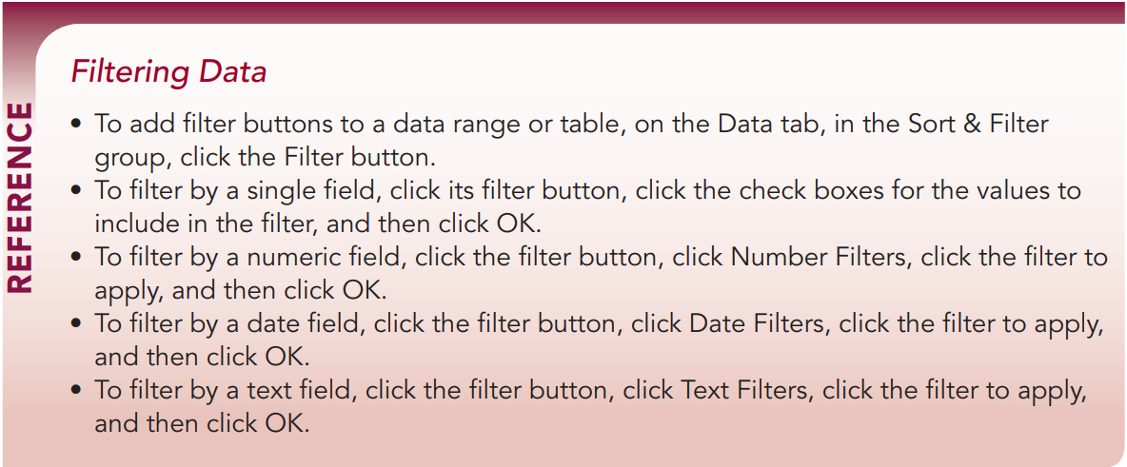
COMP1631 Advanced Spreadsheets – Winter 2024 – Section 06

Slide 48
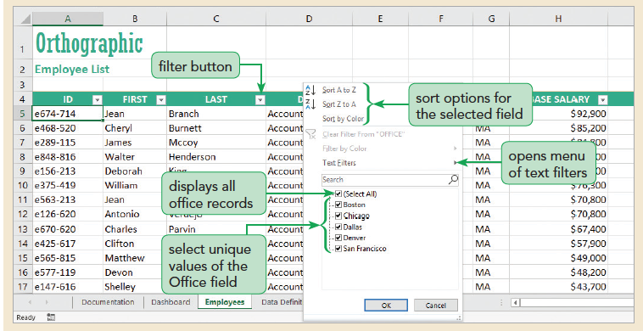
COMP1631 Advanced Spreadsheets – Winter 2024 – Section 06

Slide 49
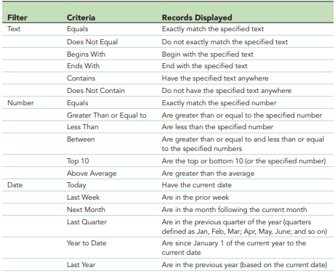
COMP1631 Advanced Spreadsheets – Winter 2024 – Section 06
Applying an Advanced Filter
Advanced filtering provides a way of writing more complicated filter criteria that involve expression that combine fields using the AND and OR logical operators.
To write an advanced filter, you must define a criteria range that lays out the specifications of the filter using Criteria Filters

Slide 50
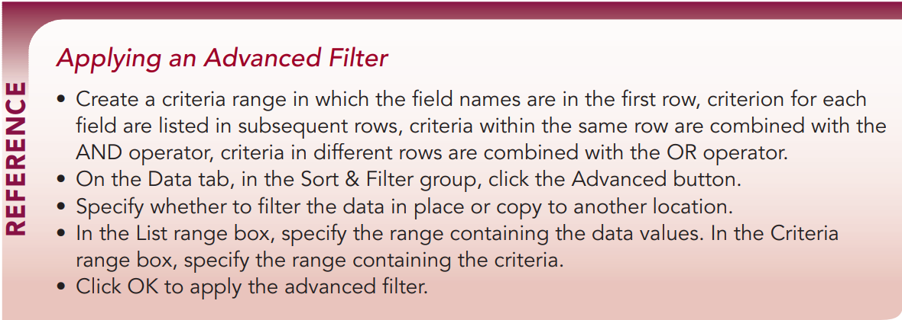
COMP1631 Advanced Spreadsheets – Winter 2024 – Section 06

Slide 51
COMP1631 Advanced Spreadsheets – Winter 2024 – Section 06
Demo NP_EX_6_Seacation:

Slide 52
COMP1631 Advanced Spreadsheets – Winter 2024 – Section 06
Creating an Excel Table
Excel tables support several features that are not available with data ranges, including:
Sorting and filtering tools built into the table itself
Table styles to format different features of the table, including banded rows and columns
Automatic insertion of a totals row containing summary statistics for each field, which update as records are inserted or deleted
Calculated values that use field names rather than cell references to make formulas easier to write and understand
Named references to different parts of the table structure, including table columns, total rows, and header rows

Slide 53
COMP1631 Advanced Spreadsheets – Winter 2024 – Section 06
An Excel table has the following structural elements:
Header row—The first row of the table containing the field names
Total row—A row at the bottom of the table containing summary statistics for selected fields
First column—The leftmost column of the table
Last column—The rightmost column of the table
Banded rows—The odd- and even-numbered rows of the table formatted differently to make records easier to distinguish
Banded columns—The odd- and even-numbered columns of the table formatted differently to make fields easier to distinguish
Filter buttons—Buttons next to each field name for filtering and sorting the table data

Slide 54
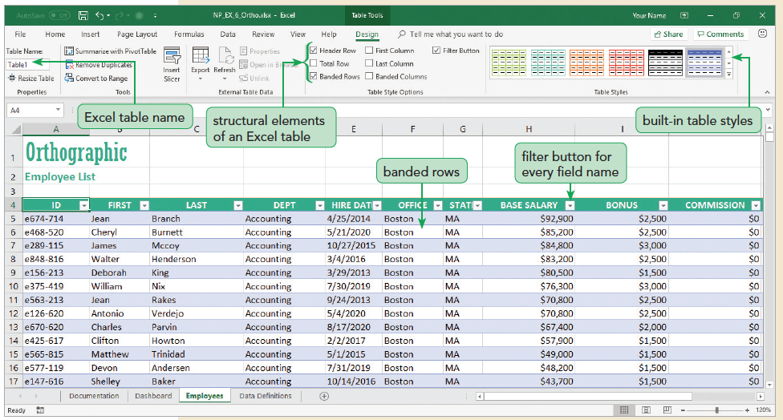
COMP1631 Advanced Spreadsheets – Winter 2024 – Section 06

Slide 55
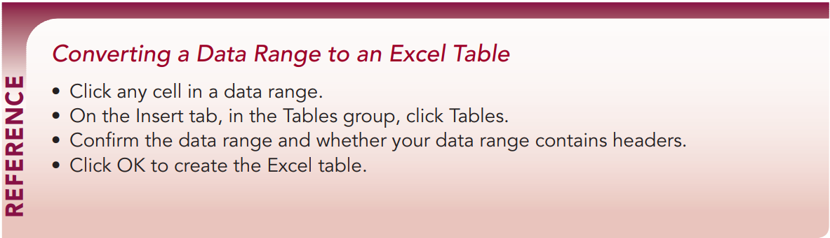
COMP1631 Advanced Spreadsheets – Winter 2024 – Section 06

Slide 56
COMP1631 Advanced Spreadsheets – Winter 2024 – Section 06
Using Table Styles
Because an Excel table is composed of structural elements, you can apply styles to different parts of the table
Table styles do not, by default, override the formatting applied to individual cells
Adding a Total Row
A useful table element for data analysis is the Total row, which is added to the end of the table after the last data record. The Total row calculates summary statistics, including the average, sum, minimum, and maximum of select fields within the table.

Slide 57
COMP1631 Advanced Spreadsheets – Winter 2024 – Section 06
Quick Quiz 5
True/False: You cannot add subtotals to an Excel table.
What are the structural elements of an Excel table?

Slide 58
COMP1631 Advanced Spreadsheets – Winter 2024 – Section 06
True/False: You cannot add subtotals to an Excel table. (Answer: True)
What are the structural elements of an Excel table?
(Answer: Header row, total row, first column, last column, banded rows, banded columns, and filter buttons)

Slide 59
COMP1631 Advanced Spreadsheets – Winter 2024 – Section 06
Adding and Deleting Records
When you add or delete records within an Excel table, the table adjusts to the new contents.
The format applied to the banded rows updates to accommodate the new data set size. The calculations in the Total row reflect the new data.

Slide 60
COMP1631 Advanced Spreadsheets – Winter 2024 – Section 06
Creating a Calculated Field
So far, all of the fields in the table contain entered values. A field can also contain a formula that references other fields in the table.
Such a field is called a calculated field, and it updates automatically as other field values in the table change. Instead of cell references, formulas in a calculated field use field names enclosed in brackets as follows: [field]
Structural References and Excel Tables
References to fields and elements in an Excel table are called structural references and are enclosed within square brackets [ ].
An important symbol in a structural reference is the @ symbol, which refers to the current record or row within the table

Slide 61
COMP1631 Advanced Spreadsheets – Winter 2024 – Section 06
More on Calculated Field and Structural References
Nested structural references to reference a group of fields in an Excel table
[[fieldFirst]:[fieldLast]]
Sum of the values in the Base Salary through Commission fields, including any fields between these two
=SUM([[Base Salary]:[COMMISSION]])
The following formula multiples the value of the SalesPrice field by the UnitSold field within the record of the table:
=[@[SalesPrice]]*[@[UnitsSold]

Slide 62
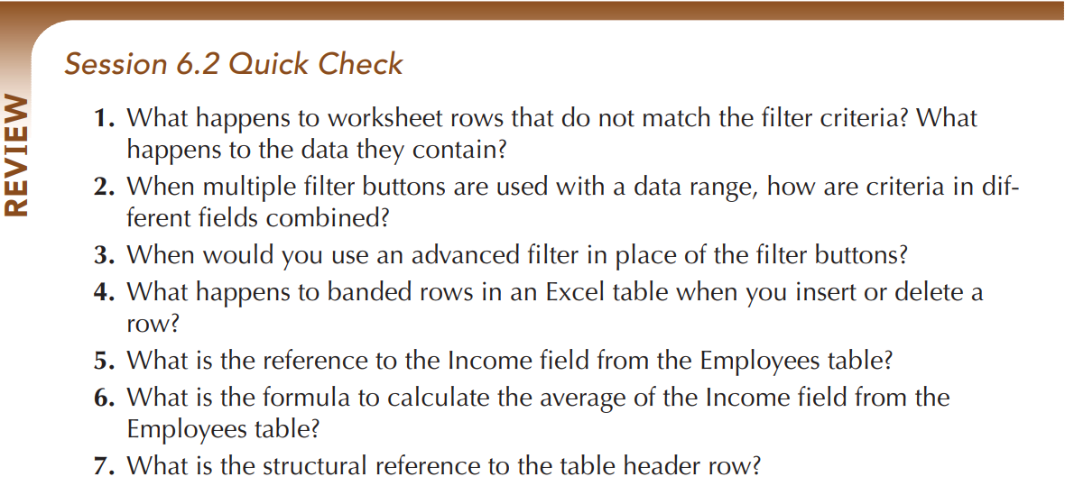
COMP1631 Advanced Spreadsheets – Winter 2024 – Section 06
Individual Work: https://forms.office.com/r/uhseTxAV4h

Slide 63
COMP1631 Advanced Spreadsheets – Winter 2024 – Section 06
6.3 Slicers and Dashboards
Filtering Data with Slicers
Creating a Slicer to Filter a PivotTable
Another way to filter a PivotTable is with a slicer
Can create a slicer for any field in the PivotTable Fields pane
The slicer contains a button for each unique value in that field
You can format the slicer and its buttons, changing its style, height, and width
You can create more than one slicer at a time

Slide 64

COMP1631 Advanced Spreadsheets – Winter 2024 – Section 06

Slide 65
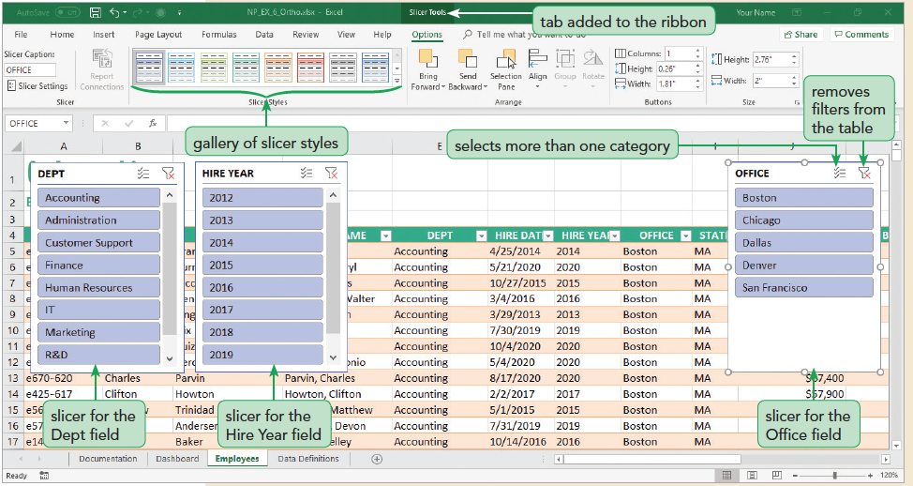
COMP1631 Advanced Spreadsheets – Winter 2024 – Section 06

Slide 66
COMP1631 Advanced Spreadsheets – Winter 2024 – Section 06
Demo NP_EX_6_Seacation:

Slide 67
COMP1631 Advanced Spreadsheets – Winter 2024 – Section 06
Quick Quiz 6
True/False: Slicers can be used with data ranges.
A __________ is an object containing a button for each unique value from a field.
What are two ways to filter data in an Excel table?
Use a _____ button when you need to use criteria filters involving text, date, or numeric values.

Slide 68
COMP1631 Advanced Spreadsheets – Winter 2024 – Section 06
True/False: Slicers can be used with data ranges.
(Answer: False)
A __________ is an object containing a button for each unique value from a field.
(Answer: slicer)
What are two ways to filter data in an Excel table?
(Answer: Slicers and filter buttons)
Use a _____ button when you need to use criteria filters involving text, date, or numeric values.
(Answer: filter)

Slide 69
COMP1631 Advanced Spreadsheets – Winter 2024 – Section 06
Creating a Dashboard
A dashboard is a page or screen providing informative visuals of data, key performance indicators, and statistics.
Most dashboards contain interactive tools to help users explore data under different conditions and assumptions.

Slide 70
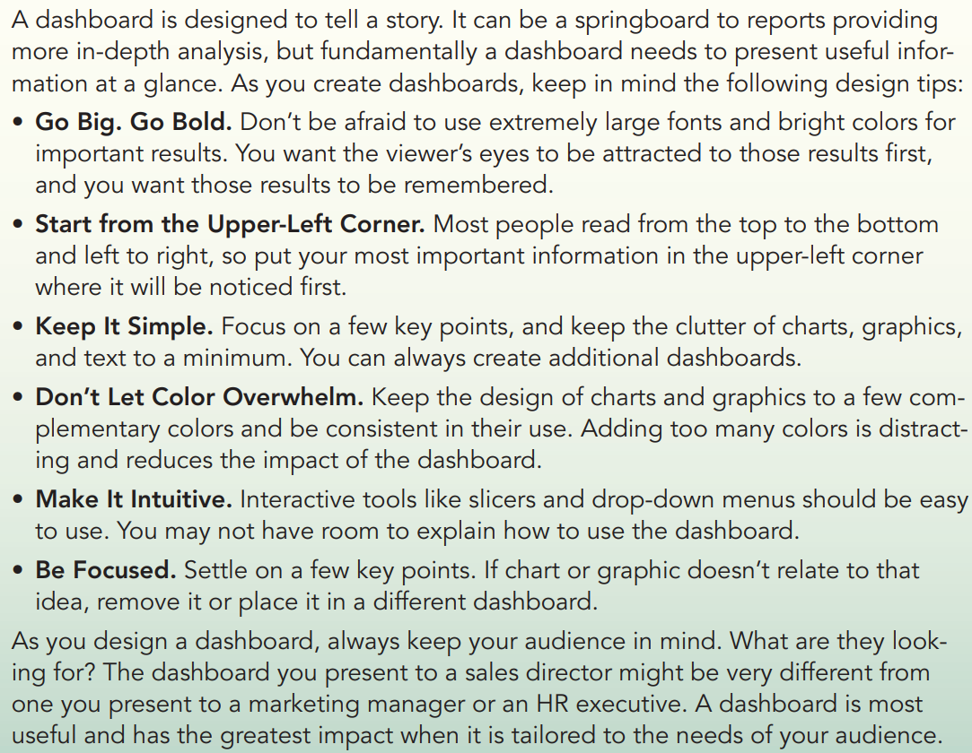

Slide 71
COMP1631 Advanced Spreadsheets – Winter 2024 – Section 06
Formatting a Slicer
By default, slicer buttons are arranged in a single column. You can increase the number of the columns by formatting the slicer.

Slide 72
COMP1631 Advanced Spreadsheets – Winter 2024 – Section 06
Using the SUBTOTAL Function
statistical functions like the COUNTA, AVERAGE, SUM, MAX, and MIN functions are applied to the entire table, regardless of any filter criteria.
To count only records that match the filter criteria, you use the SUBTOTAL function
SUBTOTAL(Function_Num, ref1, [ref2], [ref3], …)
where Function_Num is the number corresponding to a statistical function, ref1 is a reference to the data to be analyzed, and ref2, ref3, and so on are optional arguments for additional data references.

Slide 73
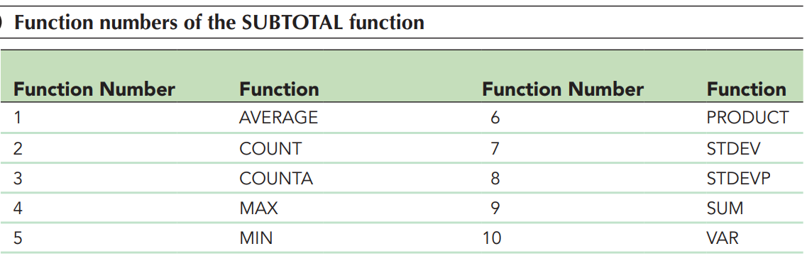
COMP1631 Advanced Spreadsheets – Winter 2024 – Section 06

Slide 74
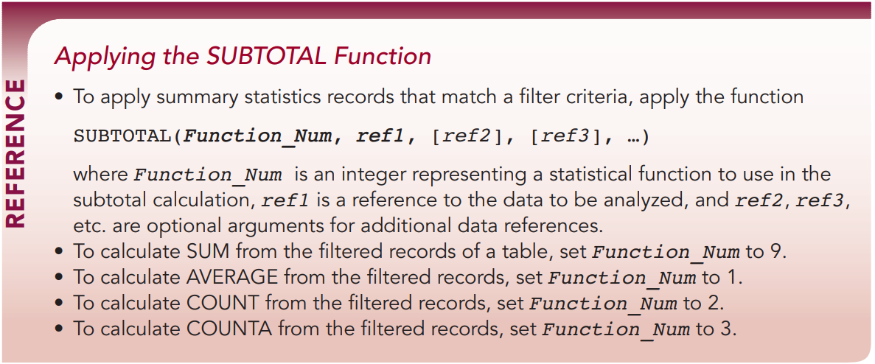
COMP1631 Advanced Spreadsheets – Winter 2024 – Section 06

Slide 75
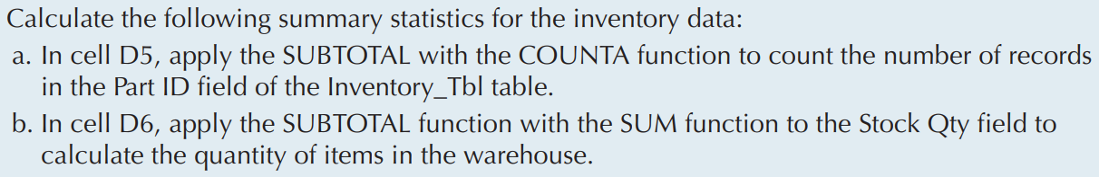
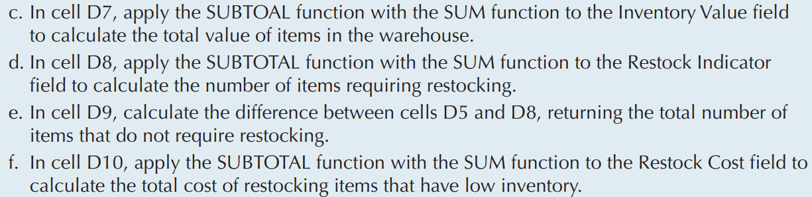
COMP1631 Advanced Spreadsheets – Winter 2024 – Section 06
Demo NP_EX_6_Seacation:

Slide 76
COMP1631 Advanced Spreadsheets – Winter 2024 – Section 06
Creating Dynamic Charts
Charts based on Excel tables are dynamic, which means they update automatically as the source data is filtered so that hidden records do not contribute to the chart’s appearance.
This dynamic quality makes charts ideal for dashboards, because the users can see visual representations of the data under varying criteria.
You should know how to create common charts such as histograms, boxplots, pie-charts, etc.

Slide 77
COMP1631 Advanced Spreadsheets – Winter 2024 – Section 06
Demo NP_EX_6_Seacation:

Slide 78
COMP1631 Advanced Spreadsheets – Winter 2024 – Section 06
Looking Up Data with Tables
Excel tables work well as lookup tables for the VLOOKUP function.
As you add more records to the lookup table, the VLOOKUP function will automatically include the additional rows.
If you filter the data, the lookup table will be restricted only to those rows that match filter criteria.
Also, you can use the table name as the lookup table reference rather than referencing a range.

Slide 79
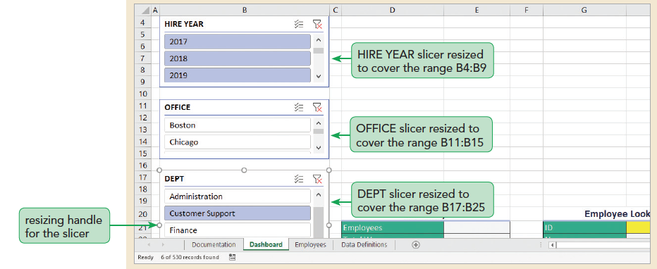
COMP1631 Advanced Spreadsheets – Winter 2024 – Section 06

Slide 80
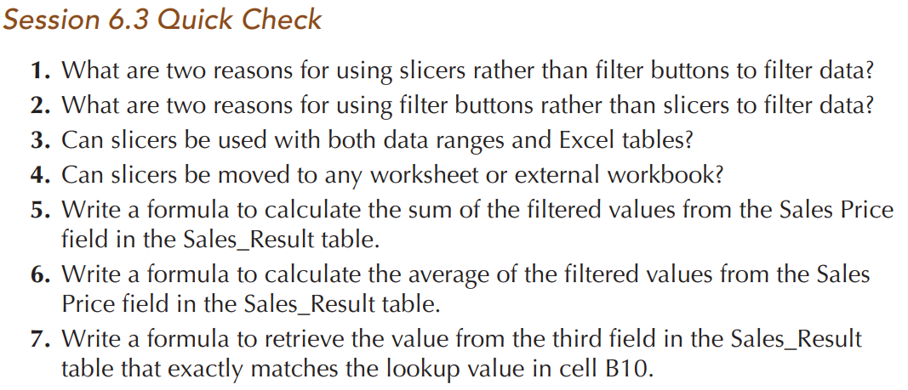
COMP1631 Advanced Spreadsheets – Winter 2024 – Section 06
Individual Work: https://forms.office.com/r/J8GHapWeq0

Slide 81
COMP1631 Advanced Spreadsheets – Winter 2024 – Section 06
Let’s go for a break ~ 10 minutes!
Return in 15 minutes (or at time specified by your instructor).

Slide 82

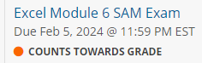
COMP1631 Advanced Spreadsheets – Winter 2024 – Section 06
Now
You are welcome to work on Excel Module 6 SAM Textbook Project.
Remember
There are items due by 11:59 on Monday Feb 5, 2024.
Have a great week!

